Slide 1
IT 601: Mobile Computing
GSM
(Most of the slides stolen from Prof. Sridhar Iyer’s lectures)

Slide 2
Cellular Concept
Base stations (BS): implement space division multiplex
  Each BS covers a certain transmission area (cell)
  Each BS is allocated a portion of the total number of channels available
  Cluster: group of nearby BSs that together use all available channels
Mobile stations communicate only via the base station, using FDMA, TDMA, CDMA…

Slide 3
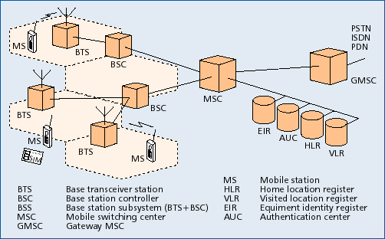
GSM: System Architecture
Notes:
This figure shows the system architecture of a GSM Public Land Mobile Network (PLMN) with its essential components.
A cell is formed by the radio area coverage of a BTS.
One BSC controls several BTS.
The combined traffic of the mobile stations in their respective cells is routed through a switch, the MSC.
Conversations originating from or terminating in a fixed network are handled by GMSC.
Several database are available for call control and network management.

Slide 4
Mobile Station (MS)
MS consists of following two components
    Mobile Equipment (ME)
    Mobile Subscriber Identity Module (SIM)
      Removable plastic card
      Stores Network Specific Data such as list of carrier frequencies and current Location Area ID (LAI).
      Stores International Mobile Subscriber Identity (IMSI) + ISDN
      Stores Personal Identification Number (PIN) & Authentication Keys.
      Also stores short messages, charging information, telephone book etc.
Allows separation of user mobility from equipment mobility
Notes:
MS consists of Mobile Equipment and Mobile Subscriber Identity Module.
GSM distinguishes explicitly between Mobile Subscriber and Mobile Equipment. It deals with them separately.
The subscriber identity is associated within a mobile station by means of a personal chip card, the SIM. SIM is a removable chip.

Slide 5
Base Transceiver Station (BTS)
One per cell
Consists of high speed transmitter and receiver
Function of BTS
  Provides two channels
      Signalling and Data Channel
  Performs error protection coding for the radio channel
Notes:
A BTS is a transmitter - receiver system that serves one cell.
It is controlled by BSC.
A BTS comprises of radio transmission and reception devices, upto and including antenna. A single transreciever within BTS supports eight basic radio channel for the same TDMA frame. BTS is able to handle three to five radio carriers, hence it can support between 24 to 40 simultaneous communications.
Message scheduling has to be made by BTS as it has the exact knowledge of BCCH/CCCH timing (not known by BSC). This includes the paging messages on the paging channel.
Random access detection has to be made by BTS, which in turn send a message to BSC. Subsequent channel assignemnet is made by BSC.
Error protection channel coding/decoding and encryption of the radio channel has to be done in BTS.
Rate adaptation is also done at BTS.
Timing Advance is also determined by the BTS. Uplink radio channel measurement has to be made by BTS.

Slide 6
Base Station Controller (BSC)
Controls multiple BTS
Functions of BSC
  Performs radio resource management
      Assigns and releases frequencies and time slots for all the MSs in its area
      Reallocation of frequencies among cells
      Hand off protocol is executed here
  Time and frequency synchronization signals to BTSs
  Time Delay Measurement and notification of an MS to BTS
  Power Management of BTS and MS
Notes:
BSC is connected to BTS on one side and MSC on the other side.
In order to keep BTS small essential control and protocol intelligence entities resides in the BSC.
It performs Radio Resource Management for all the BTS under its control. It assign and release frequencies and timeslots for all MSs in its area. It does the power management of BTSs and MSs. It provides the time and frequency synchronization reference signals to BTSs. It also measures the time delay of the received MS signal relative to the BTS clock. If the received MS signal is not centered in its assigned timeslot at the BTS, the BSC direct the BTS to notify the MS to advance the timing such that proper synchronization take place.

Slide 7
Mobile Switching Center (MSC)
Switching node of a PLMN (Public Land Mobile Network)
Allocation of radio resource (RR)
  Handoff
Mobility of subscribers
  Location registration of subscriber
There can be several MSCs in a PLMN
Notes:
The switching node of a GSM PLMN is the Mobile Switching Center (MSC). The MSC is a telephony switch that performs all the switching functions for MSs located in a geographical area designated as the MSC region.
The MSC performs all the switching functions of a fixed network switching node, eg. Routing path search, signal routing, and service feature processing. The main difference between an ISDN Switch and an MSC is that it has to consider the allocation and administration of radio resources and the mobility of the subscribers also. The MSC therefore has to provide additional functions for location registration of subscribers and for the handover of a connection in case of changing cell to cell. A PLMN can have several MSCs with each being responsible for a part of the Service Area.
The MSC must also handle different types of number and identities related to the same MS contained in different registers. IMSI, TMSI, ISDN number, MSRN etc. In general, identities are used in the interfaces between the MSC and the MS, while numbers are used in the fixed part of the Network, such as, for routing.

Slide 8
Gateway MSC (GMSC)
Connects mobile network to a fixed network
  Entry point to a PLMN
Usually one per PLMN
Request routing information from the HLR and routes the connection to the local MSC
Notes:
Dedicated Gateway MSCs (GMSCs) are available to pass voice traffic between fixed networks and mobile network.
GMSC queries the database (HLR ) and routes the connection to the local MSC in whose area the mobile station is currently staying.

Slide 9
HLR/VLR
HLR - Home Location Register
  Contains semi-permanent subscriber information
  For all users registered with the network, HLR keeps user profile
  MSCs exchange information with HLR
  When MS registers with a new GMSC, the HLR sends the user profile to the new MSC
VLR - Visitor Location Register
  Contains temporary info about mobile subscribers that are currently located in the MSC service area but whose HLR are elsewhere
  Copies relevant information for new users (of this HLR or of foreign HLR) from the HLR
  VLR is responsible for a group of location areas, typically associated with an MSC

Slide 10
AuC/EIR/OSS
AuC: Authentication Center
  is accessed by HLR to authenticate a user for service
  Contains authentication and encryption keys for subscribers
EIR: Equipment Identity Register
  allows stolen or fraudulent mobile stations to be identified
Operation subsystem (OSS):
  Operations and maintenance center (OMC), network management center (NMC), and administration center (ADC) work together to monitor, control, maintain, and manage the network

Slide 11
GSM identifiers
International mobile subscriber identity (IMSI):
  unique 15 digits assigned by service provider = home country code + home GSM network code + mobile subscriber ID + national mobile subscriber ID
International mobile station equipment identity (IMEI):
  unique 15 digits assigned by equipment manufacturer = type approval code + final assembly code + serial number + spare digit
Temporary mobile subscriber identity (TMSI):
  32-bit number assigned by VLR to uniquely identify a mobile station within a VLR’s area

Slide 12
LAI
Location Area Identifier of an LA of a PLMN
Based on international ISDN numering plan
    Country Code (CC): 3 decimal digits
    Mobile Network Code (MNC): 2 decimal digits
    Location Area Code (LAC) : maximum 5 decimal digits
Is broadcast regularly by the BTS on broadcast channel
Notes:
Each Location Area (LA) of a PLMN has its own identifier. This known as LA- ID (LAI).
The LAI is broadcast regularly by the BTS on the Broadcast Control Channel (BCCH). Thus each cell is identified uniquely on the radio channel as beloging to an LA, and each MS can determine its current location through the LAI. If the LAI "heard" by the MS changes, the MS notices this LA change and requests the updating of its location information in the VLR and HLR (locate update).
The LAI is requested from the VLR if the connection for an incoming call has been routed to the current MSC using the MSRN. This determines the precise location of the mobile station where the mobile can be subsequently paged. When the mobile station answers, the exact cell and the BTS become known; this information can then be used to switch the call through.

Slide 13
Cell Identifier (CI)
Within LA, individual cells are uniquely identified with Cell Identifier (CI).
LAI + CI = Global Cell Identity
Notes:
Within an LA the individual cells are uniquely identified by a Cell Identifier (CI), which is maximum 2x8 bits.
Together with LAI it allow unique identification of a cell internationally.
Global Cell Identity = LAI+CI

Slide 14
Air Interface: MS to BTS
Uplink/Downlink of 25MHz
  890 -915 MHz for Up link
  935 - 960 MHz for Down link
Combination of frequency division and time division multiplexing
  FDMA
      124 channels of 200 kHz
  TDMA
      Burst
Modulation used
    Gaussian Minimum Shift Keying (GMSK)
Notes:
On the physical layer GSM uses a combination of FDMA and TDMA for multiple access. Two frequency bands 45 Mhz apart have been reserved for GSM operation: 810-915 MHz for transmission from MS to BTS (Uplink) and 935-960 MHz for transmission from BTS to MS (Down link).
Each of these bands of 25 MHz width is divided into 124 single carrier channels of 200 kHz width. In each of the up-link / down-link bands there is a guard-band of 200 kHz. This variant of FDMA is also called Multi-Carrier(MC). Each Radio Frequency Channel (RFCH) is uniquely numbered, and a pair of channels with the same number forms a duplex channel with a duplex distance of 45 MHz.
The modulation used for coding is GSMK.

Slide 15
Number of channels in GSM
Freq. Carrier: 200 kHz
TDMA: 8 time slots per freq carrier
No. of carriers = 25 MHz / 200 kHz = 125
Max no. of user channels = 125 * 8 = 1000
Considering guard bands = 124 * 8 = 992 channels

Slide 16
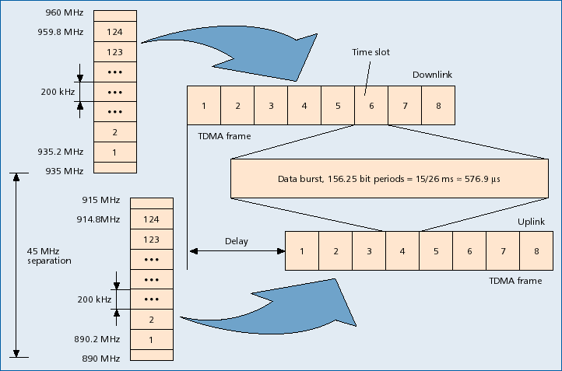

Slide 17
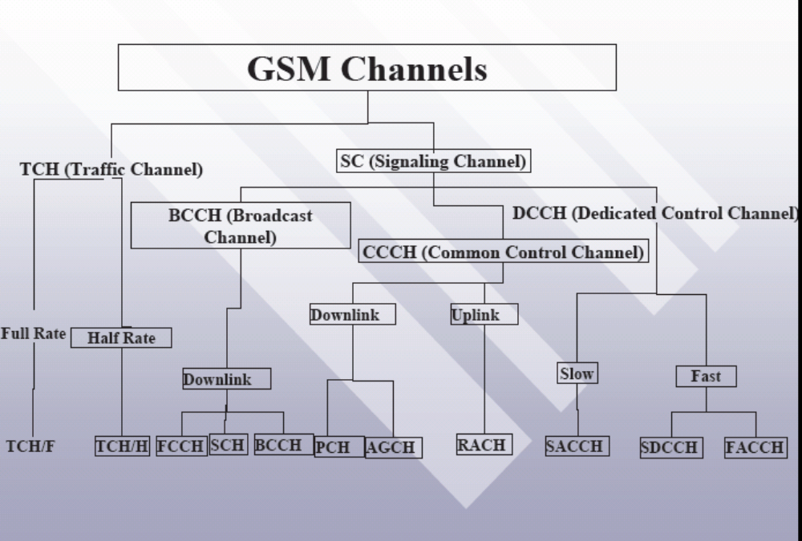
GSM Channels

Slide 18
Air Interface: Logical Channel
Traffic Channel (TCH)
  Carries user voice traffic
Signalling Channel
  Broadcast Channel (BCH) (unidirectional)
  Common Control Channel (CCH) (unidirectional)
  Dedicated/Associated Control Channel (DCCH/ACCH) (bidirectional)
Notes:
A great variety of information is transmitted between the BTS and the MS. Depending on the kind of information transmitted different logical channel is made.
Logical Channels are divided into two categories. TCHs and Control Channels
TCHs are intended to carry either encoded speech or user data.
A full rate (TCH/F), Bm, carries information at a gross rate of 22.8 kbps. The raw data rate for speech is 13kbps. A half rate (TCH/H), Lm, carries information at a gross rate of 11.4 kbps.
Signalling /Control channels are intended to carry signalling or synchronization data.
Three kinds have been defined:
BCCH: Is intended to broadcast variety of information from BTS to all the MSs (Unidirectional).
CCCH: It is bidirectional point to multipoint control channel that is primarily used for access management.
DCCH:It is point to point directional control channel. Are of two types namely Standalone Dedicated and Associated.

Slide 19
BCCH
Broadcast Control Channel (BCCH)↓
  BTS to MS
    send cell identities, organization info about common control channels, cell service available, etc
  Radio channel configuration
      Current cell + Neighbouring cells
  Synchronizing information
      Frequencies + frame numbering
  Registration Identifiers
      LA + Cell Identification (CI) + Base Station Identity Code (BSIC)
Notes:
The BCCH provides general information on a per-BTS basis (cell-specific information) including information necessary for the MS to register in the system. After intially accessing the mobile, the BTS calculates the required MS power level and send a set of power commands on this channel.
Other information sent over this channel includes country code, network code, local area code, PLMN code, RF channels used within the cell, in the surrounding cells, hopping sequence number,mobile RF channel number for allocation, cell selection parameters, and RACH description.
An important message on BCCH is organisation of CCCH. This is transmitted on a designated RF carrier using timeslot 0, denoted as C0T0.
This channel is never kept idle- either the relevant messages are sent or dummy burst is sent.
Other channels that belong to this group are the FCH and SCH.

Slide 20
FCCH & SCH
Frequency Correction Channel
    send a frequency correction data burst containing all zeros to effect a constant frequency shift of RF carrier
      Mobile station knows which frequency to use
  Repeated broadcast of Frequency Bursts
Synchronization Channel
    send TDMA frame number and base station identity code to synchronize MSs
      MS knows which timeslot to use
  Repeated broadcast of Synchronization Bursts
Notes:
The FCCH carries information for frequency correction of the MS downlink. It is required for the correct operation of a radio subsytem. Similar to BCCH this is also for point to multipoint communication. This allows MS to accurately tune to a BTS.
The SCH carries information for the frame synchronization (TDMA-frame number) of the MS and the identificationof the BTS. The SCH carries a 64 bit binary sequence that is a priori know to the MS. By correlating these bits with the internally stored 64 bits, MS achieves the exact timing with respect to a GSM frame.
The layout of SCH message is shown. It contains two encoded parameters: 1) BTS Identification Code (BSIC) and (2) Reduced TDMA Frame Number (RFN).
FCCH and BCH cann't be frequency hopped, as these channel carry synchronization and system-related information whose exact location must be known to MS.

Slide 21
AGCH & PCH
Access Grant Channel (AGCH)
  BTS to MS
  Used to assign an SDCCH/TCH to MS
Paging Channel (PCH)
  BTS to MS
  Page MS
Notes:
AGCH is used tp allocate an SDCCH or a TCH directly to an MS.
PCH is used to page (search) a MS. It is in downlink direction.
A combined paging and access grant channel is designated as PAGCH.

Slide 22
RACH & SDCCH
Random Access Channel (RACH)
  MS => BTS
  Slotted Aloha
  Request for dedicated SDCCH
Standalone Dedicated Control Channel (SDCCH)
  MS => BTS
  Standalone; Independent of Traffic Channel
  Used before MS is assigned a TCH
Notes:
RACH is an uplink channel and operates in point to point mode from MS to BTS.
It is used by MS to request allocation of an SDCCH either as a page response or for call originating/registration of MS.
The channel operates on slotted Aloha protocol and thus the contention possibilty exists. If the MS request is not answered within a specified time, the MS assumes that a collision has occurred and repeats the request.

Slide 23
DCCH
DCCH (dedicated control channel):
  bidirectional point-to-point -- main signaling channels
  SDCCH (stand-alone dedicated control channel): for service request, subscriber authentication, equipment validation, assignment to a traffic channel
  SACCH (slow associated control channel): for out-of-band signaling associated with a traffic channel, eg, signal strength measurements
  FACCH (fast associated control channel): for preemptive signaling on a traffic channel, eg, for handoff messages
    Uses timeslots which are otherwise used by the TCH

Slide 24
Select the channel with
highest RF level among
the control channels
Power On
Scan Channels,
monitor RF levels
Scan the channel for the
FCCH
Select the channel with
next highest Rf level from
the control list.
NO
Is
FCCH detected?
YES
Scan channel for SCH
NO
Is
SCH detected?
YES
Read data from BCCH
and determine is it BCCH?
From the channel data
update the control channel list
NO
Is
the current BCCH
channel included?
YES
FCCH – Freq correction channel
SCH – synchronization channel
Camp on BCCH and
start decoding

Slide 25
Adaptive Frame Synchronization
Timing Advance
Advance in Tx time corresponding to propagation delay
6 bit number used; hence 63 steps
63 bit period = 233 micro seconds (148 bits occupy 546.5 micro second)
  (round trip time)
    35 Kms (taking speed of light)
Notes:
The MS can be any where within a cell, which means the distance between MS and BTS may vary and hence the signal propogation time. Due to this the burst received at the BTS would be offset. Since TDMA is based on the exact synchronization of transmitted and received data burst it cannot tolerate any time shifts. i.e. burst transmitted by different MS in adjacent time slots must not overlap when received at the BTS by more than the guard period.
To avoid such collisions, the start of transmission time from the MS is advanced in proportion to the distance from the BTS.
The process of adapting the transmissions from the MS to the TDMA frame is called adaptive frame alignment.
To denote the timing advance 7 bits are used. The unit of it is one bit period (3.69 microsecond). The maximum time period value of 63 correspond to 63x3.69 = 232 micro second. This is the round trip time hence one way time available = 232/2 =116 micro second.
This corresponds to a maximum distance between MS and BTS of 35 km.

Slide 26
GSM: Frequency Hopping
Optionally, TDMA is combined with frequency hopping to address problem of channel fading
  TDMA bursts are transmitted in a pre-calculated sequence of different frequencies (algorithm programmed in mobile station)
  If a TDMA burst happens to be in a deep fade, then next burst most probably will not be so
  Helps to make transmission quality more uniform among all subscribers

Slide 27
Bursts
Building unit of physical channel
Types of bursts
  Normal: for transmitting messages in traffic and control channels
  Frequency Correction: sent by base station for frequency correction at mobile station
  Synchronization: sent by base station for synchronization
  Access: for call setup
  Dummy: to fill an empty timeslot in the absence of data

Slide 28
Normal Burst
Normal Burst
  2*(3 head bit + 57 data bits + 1 signaling bit) + 26 training sequence bit + 8.25 guard bit
  Used for all except RACH, FSCH & SCH
Notes:
The normal burst is used to transmit information on traffic and control (except RACH) channels. The bursts are separated through guard bands.
At the start and end of each burst are three tail bits which are always set to logical "0". These bits fill a short t ime span during which transmitter power is ramped up or down and during which no data transmission is possible.
The Stealing Flags (SF) are signalling bits which indicate whether the burst contains traffic data or signalling data.
A normal burst contains besides the synchronization and signalling bits two blocks of 57 bits each of error-protected and channel encoded user data separated by a 26-bit midamble.
This midamble consists of predefined, known bit patterns, the training sequences (discussed in detail later), which are used for channel estimation to optimize reception with an equalizer and for synchronization. With the help of these training sequences, the equalizer eliminates or reduces the intersymbol interferences which are caused by propogation time difference of the multipath propogation.

Slide 29
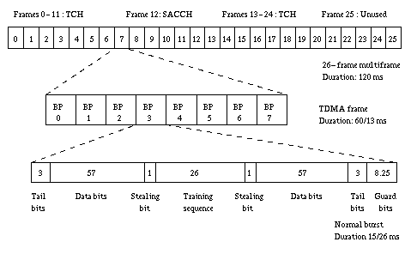
Traffic Multiframe

Slide 30
Traffic Channel
Transfer either encoded speech or user data
Bidirectional
Full Rate TCH
  Rate 22.4kbps
Half Rate TCH
  Rate 11.2 kbps

Slide 31
Full Rate Speech Coding
Speech Coding for 20ms segments
  260 bits at the output ; Effective data rate 13kbps
Unequal error protection
  182 bits are protected
  78 bits unprotected
Channel Encoding
  Codes 260 bits into (8 x 57 bit blocks) 456 bits
Interleaving
  2 blocks of different set interleaved on a normal burst (save damages by error bursts)
Notes:
Basic speech is sensed by a coder for 20ms segments and it produces 260 bits at the output. Thus the output data rate of the speech coder is 13kbps.
The residual data consisting of 182 bits and 78 bits of side information when passed through the half rate convolutional encoder provides 456 bits of coded data. Hence at every 20 ms the channel coder releases 456 bits.
The resulting 456 bit is then transmitted using an interleaving scheme. The interleaving depth is eight. This means that eight frames are used to transmit these bits.
REFER THE CHART IN THE NEXT SLIDE

Slide 32

GSM Speech Coding
104 kbps
13 kbps
Analog
speech
Low-pass
filter
A/D
RPE-LTP
speech
encoder
Channel
encoder
8000 samples/s,
13 bits/sample

Slide 33
GSM Speech Coding
Bit interleaving: to spread effects of Rayleigh fading across data blocks
channel coder
blocks
456 bits
456 bits
57-bit
segments
1
2
3
4
5
6
7
8
1
2
3
4
5
6
7
8
114-bit
segments
1
2
3
4
5
6
7
8
Normal
burst
TB
Data
H
Training
Data
H
TB
G

Slide 34
Speech
20 ms
20 ms
Speech Coder
Speech Coder
260
260
Channel Encoding
Channel Encoding
456 bit
456 bit
Interleaving
1
2
3
4
5
6
7
8
NORMAL BURST
3
57
1
26
1
57
3
8.25
Out of first 20 ms
Above 148 bits corresponds to 546.5 micro seconds
Out of second 20ms

Slide 35
Traffic Channel Structure for Full Rate Coding
Slots
1
2
3
4
5
6
7
8
1
2
3
4
5
6
7
8
1
2
Bursts for Users allocated in Slot
1
2
3
4
5
6
7
8
9
10
11
12
13
14
15
16
17
26
T
T
T
T
T
T
T
T
T
T
T
T
T
S
T
T
T
T
I
T = Traffic
S = Signal( contains information about the signal strength in neighboring cells)

Slide 36
Traffic Channel Structure for Half Rate Coding
Slots
1
2
3
4
5
6
7
8
1
2
3
4
5
6
7
8
1
2
Burst for one users
1
2
3
4
5
6
7
8
9
10
11
12
13
14
15
16
17
26
T
T
T
T
T
T
T
S
T
T
Bursts for another users allocated in alternate Slots
1
2
3
4
5
6
T =
7
8
9
10
11
12
13
14
15
16
17
26
T
T
T
T
T
T
T
T
T
S

Slide 37
SACCH & FACCH
Slow Associated Control Channel (SACCH)
  MS  BTS
  Always associated with either TCH or SDCCH
  Information
      Channel quality, signal power level
  Should always be active; as proof of existence of physical radio connection
Fast Associated Control Channel (FACCH)
  MS  BTS
      Handover
      Uses timeslots which are otherwise used by TCH (Pre-emptive multiplexing on a TCH, Stealing Flag (SF))
Notes:
It is a dedicated channel allocation of which is linked with either TCH or SDCCH.
It is a continuous data channel carrying information for the optimal operation of the radio channel, e.g.commands for synchronization and transmitter power control and report on channel measurement. This is a necessary channel for mobile assisted hand-over function. The channel is also used for time alignment and is meant for both the uplink and downlink. It is used for point-to-point communication between the MS and BTS.
Data must be sent continuously over the SACCH since the arrival of SACCH packet is taken as a proof of the existence of the physical radio connection. When there is no signalling data, the MS send a measurement report with the current results of the continuously conducted radio signal level measurement.

Slide 38
GSM: Channel Summary
Logical channels
  Traffic Channels; Control Channels
Physical Channel
  Time Slot Number; TDMA frame; RF Channel Sequence
Mapping in frequency
  124 channels, 200KHz spacing
Mapping in time
  TDMA Frame, Multi Frame, Super Frame, Channel
Notes:
The mapping of logical onto physical channels has two components: a) mapping in frequency
b) mapping in time.
The mapping of a logical channel onto a physical channel in the frequency domain is based on the TDMA frame number RFN and the frequencies allocated to base and MS.
In the time domain, the logical channels are organized by the definition of complex superstructures on top of the TDMA frames, formimg so-called multiframes, superframes and hyperframes. For the mapping of logical onto physical channels, one is interested in the multiframe doamin. These multiframes allow one to map (logical) subchannels onto physical channels.
Two kinds of multiframe are defined: a multiframe consisting of 26 TDMA frames (predominantly payload - speech and data frames) and a multi frame of 51 TDMA frames (predominantly signaling frames)

Slide 39
GSM: System Architecture
Notes:
This figure shows the system architecture of a GSM Public Land Mobile Network (PLMN) with its essential components.
A cell is formed by the radio area coverage of a BTS.
One BSC controls several BTS.
The combined traffic of the mobile stations in their respective cells is routed through a switch, the MSC.
Conversations originating from or terminating in a fixed network are handled by GMSC.
Several database are available for call control and network management.

Slide 40
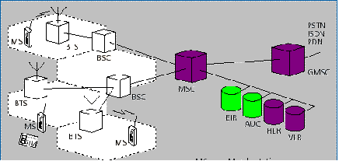
GSM
Sub-Systems
Radio Sub System (RSS)
    RSS = MS + BSS
    BSS = BTS+ BSC
Network Sub System (NSS)
    NSS = MSC+ HLR + VLR + GMSC
Operation Sub System
    OSS = EIR + AuC
Notes:
A GSM system has two major components: the fixed installed Network and the mobile subscribers.
The fixed Network is subdivided into three network.
Base Station Sub System:
It consists two components BTS in each cell and BSCs, controlling BTS.
BSS together with MSs under it comprises Radio Sub System (RSS).
Network Sub System: It consists of mobile switching centers and the databases which store the data required for routing and service provisioning. The important components are MSC,GMSC, HLR and VLR.
Operation Sub System: The ongoing network operation is controlled and maintained by Operation Sub System. It function includes: Administration and Commercial Operation, Security Management, Network Configuration etc. It is consists of AuC and EIR.

Slide 41
Example: Outgoing call setup
  User keys in the number and presses send
  Mobile transmits Set Up message on uplink signaling channel (RACH) to the MSC
  MSC requests HLR/VLR to get subscriber parameters necessary for handling the call.
  VLR/HLR sends Complete Call msg to the MSC
  MSC sends an Assignment message to the BSS and asks it to assign TCH for the MS
  BSS allocates a radio channel (TCH) and sends an Assignment message to MS over SDCCH
  MS tunes to the radio channel (TCH) and sends an Assignment Complete message to the BSS.
  BSS deallocates SDCCH. Now voice path is established between MS and MSC
  MSC completes the PSTN side of the signaling.

Slide 42
Example: Incoming Call Setup
  MSC sends “Send Routing Information” msg to HLR
  HLR acks the “Send Routing Information” to MSC which contains the LAI (Location Area Identity) and TMSI (International Mobile Subscriber Identity) of the MS.
  MSC uses the LAI to determine which BSSs will page MS
  MS ↓ BSS/MSC ------ Paging request (PCH) (contains TMSI)
  MS ↑ BSS/MSC ------ Channel request (RACH)
  MS ↓ BSS/MSC ------ Immediate Assignment (AGCH) (carries SDCCH info)
  MS ↑ BSS/MSC ------ Paging Response (SDCCH) (This SDCCH is used until TCH is allocated)
  MS ↓ BSS/MSC ------ Authentication Request (SDCCH)
  MS ↑ BSS/MSC ------ Authentication Response (SDCCH)
  MS ↓ BSS/MSC ------ Setup (SDCCH)
  MS ↑ BSS/MSC ------ Call Confirmation (SDCCH)
  MS ↑ BSS/MSC ------ Alert (SDCCH)
  MS ↑ BSS/MSC ------ Connect (SDCCH)
  MS ↓ BSS/MSC ------ Connect Acknowledge (SDCCH)
  MS BSS/MSC ------ Data (TCH)
Notes:
The figure shows an example of incoming call connection setup at the air interface how the various logical channels are used in principle.
The MS is called via the PCH and requests a signaling channel on the RACH. It gets SDCCH through an IMMEDIATE ASSIGNMENT message on the AGCH. Then follow authentication, start of ciphering, and start of setup over the SDCCH. An ASSIGNMENT COMMAND message gives the traffic channel to the MS, which acknowledges its receipt on the FACCH of the traffic channel. The FACCH is also used to continue the connection setup.

Slide 43
GSM: Identification
Identification of Mobile Subscriber
    International Mobile Subscriber Identity (IMSI)
    Temporary IMSI (TMSI)
    Mobile Subscriber ISDN number (MSISDN)
Identification of Mobile Equipment
    International Mobile Station Equipment Identification (IMEI)
    Mobile Station Roaming Number (MSRN)

Slide 44
IMSI
International Mobile Subscriber Identity
Stored in SIM, not more than 15 digits
      3 digits for Mobile Country Code (MCC)
      3 digits for Mobile Network Code (MNC)
        It uniquely identifies the home GSM PLMN of the mobile subscriber.
      Not more than 10 digits for National Mobile Station Identity (MSIN)
        The first 3 digits identify the logical HLR-ID of the mobile subscriber
MNC+MSIN makes National Mobile Station Identity (NMSI)
Notes:
When registering for services with a mobile operator, each subscriber receives a unique identifier, the IMSI.
IMSI consists of several parts as shown in the figure.
A mobile station can only be operated, if a valid SIM with a valid IMSI is inserted into equipment with a valid IMEI.
The IMSI is a GSM specific addressing concept in contrast to the ISDN numbering plan.

Slide 45
TMSI and LMSI
Temporary Mobile Subscriber Identity
    Has only local and temporal significance
    Is assigned by VLR and stored there only
    Is used in place of IMSI for security reasons
Local Mobile Subscriber Identity
    Is an additional searching key given by VLR
    It is also sent to HLR
Both are assigned in an operator specific way
Notes:
TMSI has only local significance in the area handled by the VLR. VLR responsinble for the current location of a subscriber assign to the MS its TMSI.
It is used in place of the IMSI for the definite identification and addressing of the mobile station. In this way no one can determine the identity of the subscriber by listening to the radio channel, since this TMSI is only assigned during the mobile station's presence in the area of one VLR, and can even be changed during this period (ID hopping). The mobile station stores the TMSI on the SIM card. The TMSI is stored on the network side only in the VLR and is not passed on to the HLR.
Together with current location area, a TMSI allows a subscriber to be identified uniquely, ie. for the ongoing communication the IMSI is replaced by the 2-tuple (TMSI & LAI).
A TMSI is local hence may therefore be assigned in an operator-specific way.

Slide 46
MSISDN
“real telephone number” of a MS
It is stored centrally in the HLR
MS can have several MSISDNs depending on SIM
It follows international ISDN numbering plan
    Country Code (CC): upto 3 decimal places
    National Destination Code (NDC): 2-3 decimal places
    Subscriber Number (SN) : maximal 10 decimal places
      MSISDN = CC + NDC + SN
Notes:
The "real telephone number" of a mobile station is the Mobile Subscriber ISDN Number (MSISDN). It is assigned to the subscriber (his or her SIM respectively) such that a mobile station can have several MSISDNs depending on the SIM.
With this concept, GSM is the first mobile system to distinguish between subscriber identity and number to call.
The separation of call number (MSISDN) and subscriber identity IMSI primarily serves to protect the confidentiality of the IMSI.
A subscriber can hold several MSISDNs for selection of different services, depending upon SIM. Thus an automatic activation of service-specific resources is already possible during the setup of a connection.

Slide 47
GSM roaming
VLR registers users roaming in its area
  Recognizes mobile station is from another PLMN
  If roaming is allowed, VLR finds the mobile’s HLR in its home PLMN
  VLR constructs a global title from IMSI to allow signaling from VLR to mobile’s HLR via public telephone network
  VLR generates a mobile subscriber roaming number (MSRN) used to route incoming calls to mobile station
  MSRN is sent to mobile’s HLR

Slide 48
GSM roaming
VLR contains
  MSRN
  TMSI
  Location area where mobile station has registered
  Info for supplementary services (if any)
  IMSI
  HLR or global title
  Local identity for mobile station (if any)

Slide 49
GSM handoffs
Intra-BSS: if old and new BTSs are attached to same base station
  MSC is not involved
Intra-MSC: if old and new BTSs are attached to different base stations but within same MSC
Inter-MSC: if MSCs are changed

Slide 50
GSM Intra-MSC handoff
Mobile station monitors signal quality and determines handoff is required, sends signal measurements to serving BSS
Serving BSS sends handoff request to MSC with ranked list of qualified target BSSs
MSC determines that best candidate BSS is under its control
MSC reserves a trunk to target BSS
Target BSS selects and reserves radio channels for new connection, sends Ack to MSC
MSC notifies serving BSS to begin handoff, including new radio channel assignment

Slide 51
GSM Intra-MSC handoff
Serving BSS forwards new radio channel assignment to mobile station
Mobile station retunes to new radio channel, notifies target BSS on new channel
Target BSS notifies MSC that handoff is detected
Target BSS and mobile station exchange messages to synchronize transmission in proper timeslot
MSC switches voice connection to target BSS, which responds when handoff is complete
MSC notifies serving BSS to release old radio traffic channel

Slide 52
GSM Inter-MSC handoff
MS sends signal measurements to serving BSS
Serving BSS sends handoff request to MSC
Serving MSC determines that best candidate BSS is under control of a target MSC and calls target MSC
Target MSC notifies its VLR to assign a TMSI
Target VLR returns TMSI
Target MSC reserves a trunk to target BSS
Target BSS selects and reserves radio channels for new connection, sends Ack to target MSC
Target MSC notifies serving MSC that it is ready for handoff

Slide 53
GSM Inter-MSC handoff
Serving MSC notifies serving BSS to begin handoff, including new radio channel assignment
Serving BSS forwards new radio channel assignment to mobile station
Mobile station retunes to new radio channel, notifies target BSS on new channel
Target BSS notifies target MSC that handoff is detected
Target BSS and mobile station synchronize timeslot
Voice connection is switched to target BSS, which responds when handoff is complete
Target MSC notifies serving MSC
Old network resources are released

Slide 54
GSM Security
Access Control and Authentication
  User should not be able to use the GSM resources without being authenticated
Confidentiality
  Messages containing user related information should not be accessible to others
Anonymity
  User identifier is not used over the air

Slide 55
GSM Security
Access Control and authentication
  GSM handsets must be presented with a subscriber identity module (SIM)
  SIM must be validated with personal identification number (PIN)
  SIM also stores subscriber authentication key, authentication algorithm, cipher key generation algorithm, encryption algorithm

Slide 56
GSM Security
  During registration (when roaming), mobile station receives “challenge” and uses authentication key and authentication algorithm to generate “challenge response” to verify user’s identity
Confidentiality (Privacy from eavesdropping)
  Temporary encryption key is used for privacy of data, signaling, and voice
  Info is encrypted before transmission

Slide 57
GSM Security
Anonymity of users
  Supported by temporary mobile subscriber ID (TMSI)
  When registered, mobile station sends globally-unique international mobile subscriber ID (IMSI) to network
  Network assigns TMSI for use during call - IMSI is not sent over radio link
  Only network and mobile station know true identity
  New TMSI is assigned when roam into new area

Slide 58
GSM Summary
Uplink frequencies
890-915 MHz
Downlink frequencies
935-960 MHz
Total GSM bandwidth
25 MHz up + 25 MHz down
Channel bandwidth
200 kHz
Number of RF carriers
124
Multiple access
TDMA
Users/carrier
8
Number of simul. users
992
Speech coding rate
13 kb/s
FEC coded speech rate
22.8 kb/s

Slide 59
GSM service quality requirements
Speech intelligibility
90%
Max one-way delay
90 ms
Max handoff gap
150 ms if intercell
Time to alert mobile of
inbound cell
4 sec first attempt,
15 sec final attempt
Release time to called
network
2 sec
Connect time to called
network
4 sec

Slide 60
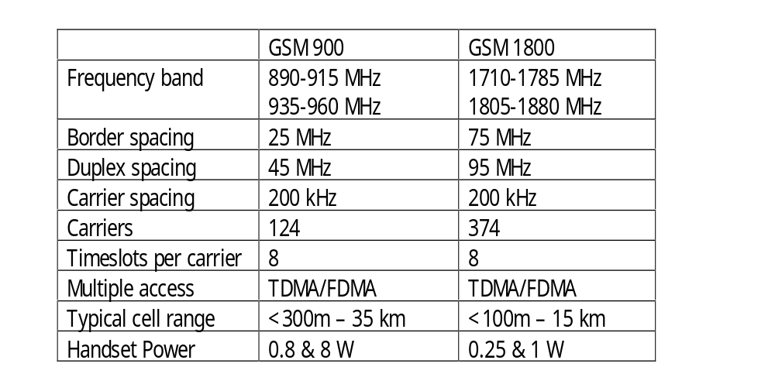
GSM 900 and GSM 1800

